Slide 1
— Topic 7 Dynamic Binding and Polymorphism
Notes:
To create Em dash above headline:
Same size and weight as the headline and set using a soft return.
PC: Em dash (—): Alt+Ctrl+ - (minus)
Mac: Em dash (—): Shift+Alt/Option+hyphen

Slide 2
Dynamic Binding and Polymorphism
Polymorphism and Dynamic Binding
Casting and Conversion
Use of keyword instanceof

Slide 3
Polymorphism
When I tell someone at home to feed the pets they know it means different things for different type of pets.
Hence We can consider the action feed to be polymorphic.
In OOP, polymorphism promotes code reuse by calling the method in a generic way.
For example we can say deduct $5.00 monthly charges by calling the withdraw() method on all account objects. But depending on the type of account the correct version of withdraw() will be called.

Slide 4
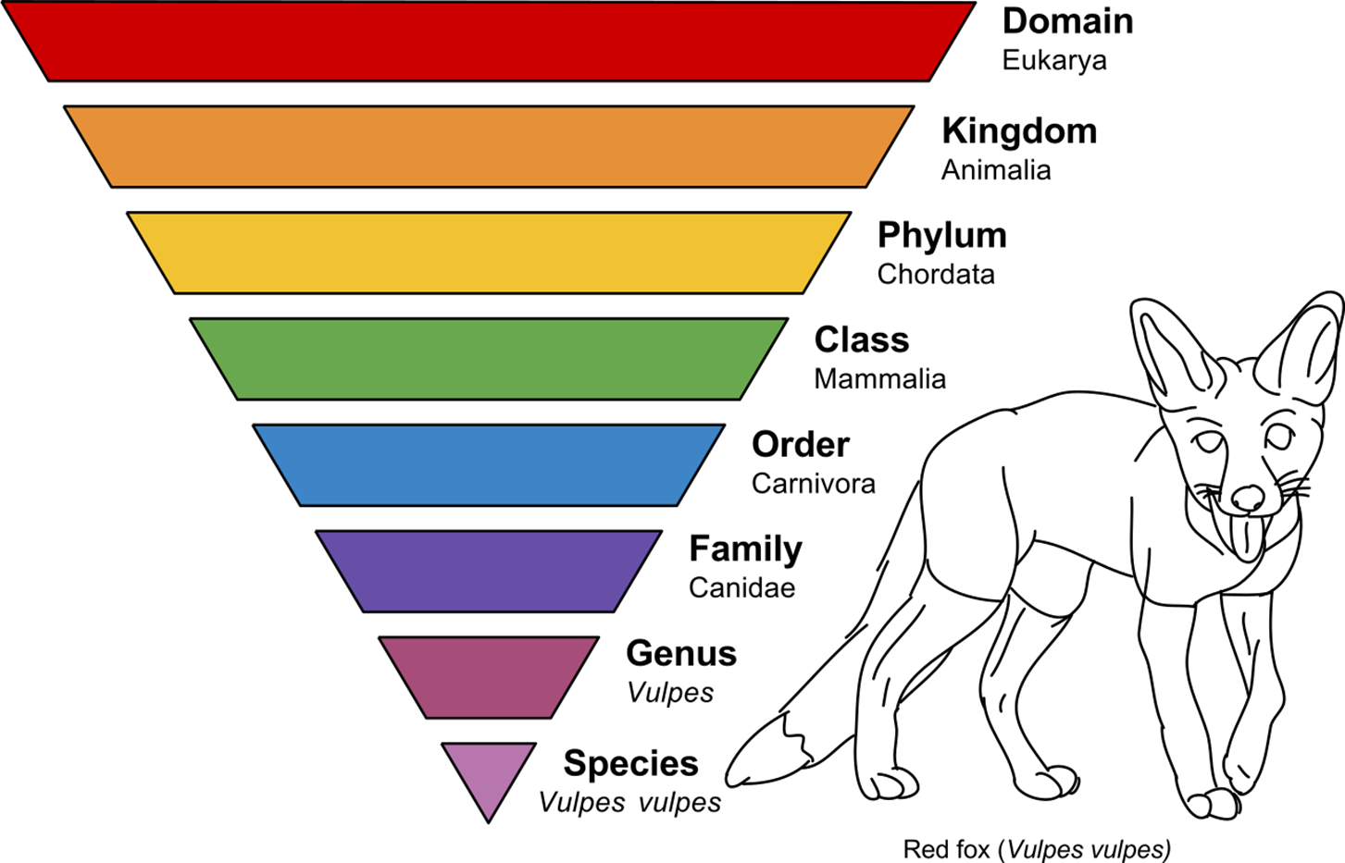
This makes for a deep inheritance heirarchy!
From: https://en.wikipedia.org/wiki/Animal

Slide 5
Object Reference Conversion
To enable methods to be called in a polymorphic way Java allows a superclass reference to refer to a subclass object.
As SAccount and CAccount extend the class Account both of these statements are valid.
Account account1;
...
account1 = new SAccount(“s123”,”Tom”, 100, 0);
...
account1=new CAccount(“c123”,”Kim”,2000,1000);
...
Account reference
account1
SAccount
Account reference
account1
CAccount

Slide 6
Invoking methods through Superclass Reference
When Account reference account1 referring to a subclass object is used to invoke a method such as withdraw(), the overridden withdraw() of that subclass is invoked.
Account account1 = new SAccount(“s123”,”Tom”,100, 0);
account1.withdraw(100); // withdraw of SAccount invoked
account1 = new CAccount(“c343”,”Kim”,2000,1000);
account1.withdraw(200); // withdraw of CAccount invoked
Account
CAccount
withdraw()
deposit()
SAccount
Account reference account1
withdraw()
deposit()
addCharge()
withdraw()
deposit()
addInterest()
subclass methods,
not part of superclass Account

Slide 7
Invoking methods through Superclass Reference
However, the compiler will report an error if we attempt to call the addInterest() of SAccount or deductCharge() of CAccount through an Account reference.
Can I say walk the pets if I have a fish, dog and a bird as a pets ?
Account account1 = new SAccount(“s123”,”Tom”,100, 0);
account1.addInterest(1.0); // Error
Account
CAccount
withdraw()
deposit()
SAccount
Account reference account1
withdraw()
deposit()
addCharge()
withdraw()
deposit()
addInterest()
subclass methods,
not part of superclass Account

Slide 8
Summary
A superclass reference can refer to a subclass object.
However only methods of that superclass interface can be called through this reference. The actual method called (whether it is of the superclass or one of its subclasses) depends on the type of object being referred.
To call other methods not found in the superclass we need to cast the reference to the appropriate type.

Slide 9
Casting references
If we know that the Account reference account1 is referring to a SAccount object, we can use a cast to convert it back. Such a reference can then be used to call any of the subclass methods.
Account account1 = new SAccount(“s123”,”Tom”,100, 0);
account1.withdraw(100); // OK
account1.addInterest(1.0); // Error
SAccount account2 = (SAccount) account1;
// now all methods of SAccount can be accessed
account2.withdraw(100); // OK
account2.addInterest(1.0); // OK
If however the reference account1 happened to point to an object of some other type (other than SAccount) an exception will be thrown at run-time.

Slide 10
Summary of Casting
A superclass reference can be cast to a subclass reference if we are sure it is referring to a subclass object.
The program will throw an exception and terminate at run-time if it is cast wrongly.

Slide 11
An analogy in English ...
We have a new tutor Mr Lim. He will be taking our tutes.
We can safely replace the reference he by that-person to get
We have a new tutor Mr Lim. That person will be taking our tutes.
We have a new tutor Poon Yap Ching. That person will take all our tutes.
We can replace the reference that-person by he if we know that person is a male.
We have a new tutor Mr Lim. He will be taking our tutes.
We cannot however replace the reference he by she

